Slide 1
Research in Geography Research Proposal: Heat Wave 2019: Distribution of urban heat-islands in Berne, 26th and 27th of June 2019
Michèle Grindat, Brian Schweigler, Dominik Ummel
Universität Bern

Slide 2
Introduction
Increase in extreme weather events
Heat Waves → Urban Heat Islands
Stadtgrün Bern
Identify Heat Islands within the City of Bern
No Heatmaps to use
Goal: Create a Heatmap for the night from June 26th to June 27th 2019

Slide 3
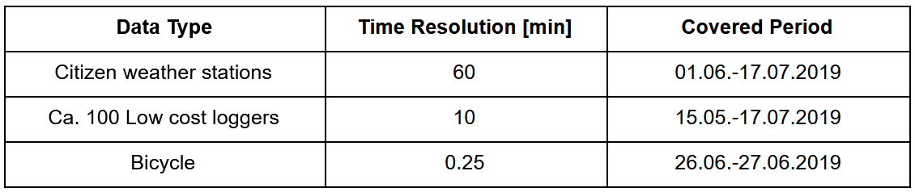
Resources
Citizen Weather Stations
Lowcost Loggers
Bicycle Measurements

Slide 4
Methodology
Spatial and Temporal Distance Matrices between bicycle and logger measurements
Average Temperatures for Logger and Citizien Weatherstation datasets
Overview Maps to assess temperature distribution
Interpolation of the Temperature between measurement spots

Slide 5
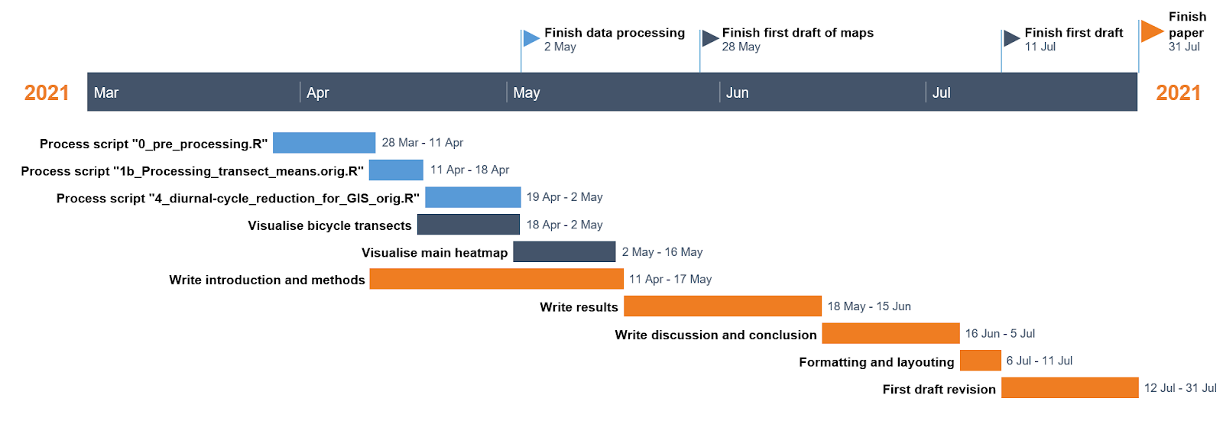
Timetable

Slide 6
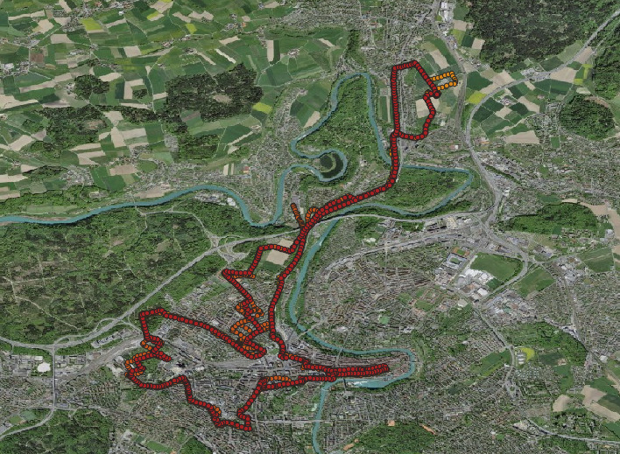
Questions

